Slide 1
Relative Frequency
11/13/13

Slide 2
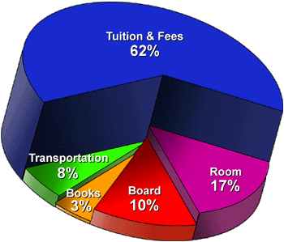
SWBAT – Interpret and create frequency distributions and histograms given a data set
What are the two biggest expenses for a college student?
What are the smallest expenses?

Slide 3
Do Now
As part of an environmental science project, you measure the trees in a park to the nearest foot. Your data is below. You want to estimate the number of trees between 30 feet and 60 feet tall. Choose a method for estimating and state any assumptions you make. What is your estimate? Explain your reasoning.
Tree Height

Slide 4
Objectives
SWBAT make and interpret frequency tables and histograms.

Slide 5
Essential Questions
What is a frequency table and histogram? Why do we use them?

Slide 6
Vocabulary
Frequency- the number of data values in an interval
Frequency table- groups a set of data values into intervals and shows the frequency for each interval
Histogram- is a graph that can display data from a frequency table. Note: histograms has one bar for each interval, there are no gaps, and bars are usually of equal width.

Slide 7
Making a Frequency Table
The number of home runs by batter in a local home run derby are listed below. Create a frequency table for the data.
7 17 14 2 7 9 5 12 3 10 4 12 7 15
Home Run Results
Home Runs | Frequency
2-5
6-9
10-13
14-17

Slide 8
You Try It!
Create a frequency table for the data in first problem using intervals of 5.

Slide 9
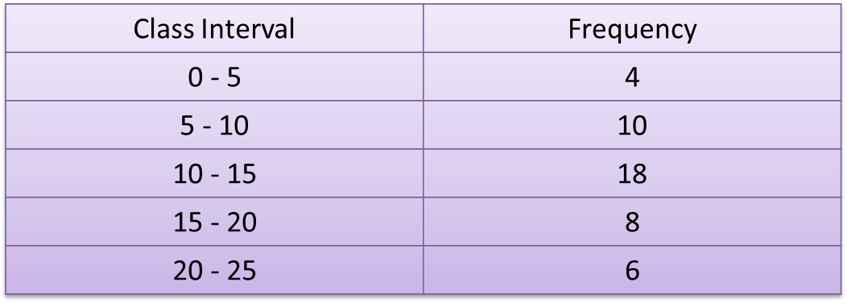
Making a Histogram
Create a histogram for the data below

Slide 10
Solution

Slide 11
You Try It!
Create a histogram for the data.
Watching Television
Hours | Frequency
0-5 | 6
6-11 | 5
12-17 | 3
18-23 | 1

Slide 12
Making a Cumulative Frequency Table
Step 1- divide the data into equal intervals.
Step 2- write the intervals into the first column. Record the frequency of each interval in the second column.
Step 3- in the third column, add the frequency of each interval to the frequencies of all the previous intervals.

Slide 13
Intervals
Suppose you had the following data which consists of the hours spent each week watching television as reported by a group of 38 teenagers.
13, 20, 17, 36, 25, 21, 9, 32, 20, 17, 12, 19, 5, 8, 11, 28, 25, 18, 19, 22, 4, 6, 0, 10, 16, 3, 27, 31, 15, 18, 20, 17, 3, 6, 19, 25, 4, 7
Explain why each of the following sets of intervals is NOT correct for grouping the data set.
A.
Too few intervals
Inconsistent class size
Interval
25 - 38
13 - 24
0 - 12

Slide 14
Intervals Continued
B.
Interval
30 - 39
20 - 29
10 - 19
5 - 9
0 - 4
C.
Interval
32 - 34
24 - 32
16 - 24
8 - 16
0 - 8
D.
Interval
33 - 40
25 - 32
17 - 24
9 - 16
1 - 8
Inconsistent intervals
Inconsistent class size
Overlapping intervals
Max not covered
Min not covered

Slide 15
Example
The number of text messages sent on one day by different family members are shown below. Create a cumulative frequency table that represents the data. 17 3 1 30 11 7 1 5 2 39 22 13 2 0 21 1 49 41 27 2 0
Daily Text Messaging
Number of Text Messages | Frequency | Cumulative Frequency
0-9 | 11 | 11
10-19 | 3 | 14
20-29 | 3 | 17
30-39 | 2
40-49 | 2

Slide 16
NOTES
Question #1

Slide 17
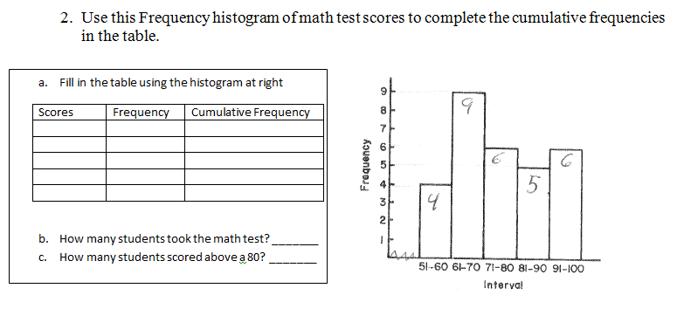
NOTES continued

Slide 18
Practice
Students will complete p. 723#1-3 and 7-13.

